Slide 1
Fetal Circulation, Gas Exchange & Changes at Birth
MMed. I Lecture
By
Dr. A. Mutungi

Slide 2
Session Objectives
At the end of this session, students will be able to:
  Discuss fetal circulation
  Discuss gas exchange between mother & fetus
  Describe changes at Birth

Slide 3
Fetal Circulation (I)
Fetus dependent upon mother for all materials necessary for growth & development
Fetal-maternal exchange of oxygen, hormones, heat, carbon dioxide & other waste products is through placenta
These contents get to and from fetus across placenta, through the single umbilical vein and the 2 umbilical arteries

Slide 4
Fetal Circulation (II)
Circulation during fetal life depends to some extent on:
  Low systemic vascular resistance & high pulmonary vascular resistance due to resistance from the collapsed lungs
  Shunts from the right to the left side of circulation

Slide 5
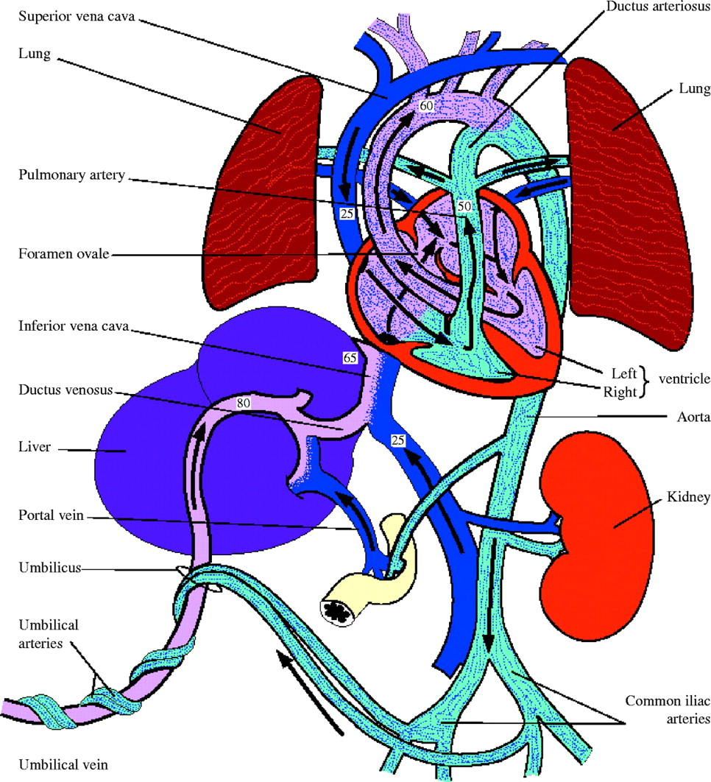
Figure 1: The fetal circulation
Ref. - Murphy, P. J. Contin Educ Anaesth Crit Care Pain 2005 5:107-112

Slide 6
Fetal Circulation (III)
Umbilical vein transfers oxygen & nutrients from mother to fetus
Umbilical vein enters fetus through umbilical ring, ascends along anterior abdominal wall to the liver, divides into Portal Sinus and Ductus Venosus

Slide 7
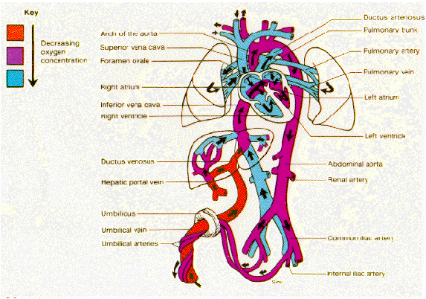

Slide 8
Fetal Circulation (IV)
Blood flow thru’ Portal sinus and Ductus venosus (DV):
Portal sinus – carries blood to hepatic veins of the left side of liver – drains into inferior vena cava (IVC)
Ductus venosus (DV) - the major branch – traverses liver & enters IVC - also carrying some less oxygenated blood from veins draining body parts below level of diaphragm. There is thus admixture of well oxygenated blood from DV & less well oxygenated blood from lower part of fetal body

Slide 9
Fetal Circulation (V)
Blood from IVC has less O2 than that leaving placenta, but more than that from superior vena cava (SVC)
Blood from IVC enters RT atrium, is directed through foramen ovale (FO) directly into the LT atrium
LT atrium receives a larger quantity of predominantly oxygenated blood through FO & a small amount of deoxygenated blood from pulmonary veins, and passes the blood to LT ventricle
Blood from LT ventricle is more highly oxygenated & thru’ aorta perfuses the heart & brain (vital organs) thru’ coronary & carotid arteries, & also upper limbs

Slide 10
Fetal Circulation (VI)
Blood from SVC is less oxygenated & passes into RT ventricle – then is ejected into pulmonary trunk; as resistance in pulmonary vessels is high, most of the blood is shunted through ductus arteriosus into the descending aorta, then to the trunk & lower limbs
Only about 1/3 of blood goes through lungs & returns to left atrium via pulmonary veins

Slide 11
Fetal Circulation (VII)
Both ventricles of the fetal heart , due to the shunts, work in parallel rather than in series
Fetal cardiac output is about 225ml/kg per minute (in sheep & baboon but thought to be similar in man). This high cardiac output is ≈x3 that of adult at rest – helps to compensate for low O2 content of fetal blood
High cardiac output is accomplished in part by the fast heart rate & low systemic (peripheral resistance in fetus)

Slide 12
Fetal Circulation (VIII)
The two umbilical arteries (arising from the internal iliac) carry deoxygenated blood from fetal body into intervillous space of placenta where it is in close contact with maternal blood which is richly oxygenated
Umbilical arteries have thick musculature arranged in a helical fashion & are highly contractile

Slide 13
Fetal Circulation (IX): Autonomic Control (a)
Reflex control of heart & circulation is complex:
  Sympathetic & parasympathetic nerve endings demonstrated in the fetal myocardium
  Fully developed aortic & carotid chemoreceptors, innervated by sinus nerve, respond to stimuli e.g. hypoxia, acidosis, hypotension resulting in hyperventilation, tachycardia & HT

Slide 14
Fetal Circulation (X): Autonomic Control (b)
Reflex control of heart & circulation contd
  Aortic chemoreceptors more important than carotid in regulation of fetal circulation
  PGs have been shown to affect fetal circulation via influence on calcium metabolism e.g.
    PGE & PGI2 encourage vasodilatation
    PGF & thromboxane cause vasoconstriction

Slide 15
Fetal Gas Exchange (I)
During fetal life, the lungs are functionless
Placenta is the organ through which exchange of gases takes place
Fetus receives oxygenated blood from he mother through the placenta (except during early stages of development when the yolk sac & uterine veins carry nutrients & gases to embryo)

Slide 16
Fetal Gas Exchange (II)
Oxygen (O2):
Fetal O2 tension in umbilical vein is significantly lower than the corresponding maternal values
This results in a significant maternal-fetal gradient essential for transfer of O2 to the fetus
Effective O2 transport by fetal blood to peripheral tissues is facilitated by 2 compensatory mechanisms
  Higher O2 affinity of fetal blood than the maternal (fetal blood less responsive to 2,3, diposphoglycerate)
  Significantly ↑fetal O2 capacity than that of the mother

Slide 17
Fetal Gas Exchange (II)
Carbon dioxide (CO2):
Maternal CO2 tension is lower than in non-pregnant state and lower than in fetus, creating a gradient for exchange

Slide 18
Changes at birth (I)
Initiation of breathing:
There is a fall in pressure in pulmonary circulation which approximates that of aorta
Therefore flow through DA ceases; by contraction of its muscular wall & later proliferation of the intima it forms the ligamentum arteriosum. Closure of the DA may also be under nervous control (there are numerous nerve endings in the tunica media)

Slide 19
Changes at birth (II)
Expansion of the lungs results in increase in pressure & amount of blood in the left atrium
Cessation of placental circulation results in fall in pressure in inferior vena cava and thus decreased pressure on the right

Slide 20
Changes at birth (III)
Difference in pressures between left & right atria leads to closure of foramen ovale – by the flexible septum primum being pressed against the right septum secundum
Intermittent flow of blood may occur in the first few days after birth
Complete fusion of the two septa occurs in about 75% of all individuals

Slide 21
Changes at birth (IV)
Changes at level of umbilical arteries & veins:
Umbilical arteries close functionally a few minutes after birth by contraction of the smooth musculature, & then by proliferation of the intima in about 2 – 3 months
Proximal portions of the arteries remain open as the superior vesical arteries, while obliteration of remaining part leads to formation of lateral vesico-umbilical ligaments
Obliteration of umbilical veins & ductus venosus follows that of umbilical arteries

Slide 22
Conclusions
Knowledge of fetal circulation is important for appropriate care during perinatal period
Establishment of fetal breathing is dependent upon changes in pressure at delivery of the baby

Slide 23
THANK YOU

